Slide 1
Optimizing Supply Chain Efficiency in the Fashion and Beauty Industry
AMAL U RAJA

Slide 2

Charts Used in Power BI Dashboards
Stacked Bar Chart: Used for comparing multiple categories across different groups. It helps in visualizing the composition of categories and their distribution across different items.
Donut Chart: Similar to a pie chart but with a center hole. It helps in showing proportional relationships while maintaining space for additional information.
Line Chart: Ideal for showing trends over time. It helps in identifying patterns, fluctuations, and trends across variables.
Slicer: Used for filtering the data dynamically. It helps in focusing on a subset of data based on selected criteria.
Pie Chart: Used for part-to-whole analysis. It helps in understanding the proportion of each category relative to the whole.
Scatter Chart: Used for showing the relationship between two variables. It helps in identifying patterns, correlations, or outliers in data.
Table: Displays detailed data in tabular form. It helps in showing exact values for analysis and comparison.
Clustered Column Chart: Used for comparing multiple categories within different groups. It helps in visualizing category-wise performance and trends.
Stacked Column Chart: Displays cumulative data for categories across different groups. It helps in understanding how each category contributes to the total.

Slide 3


Data Set
Product Type
SKU
Price
Availability
Number of products sold
Revenue generated
Customer demographics
Stock levels
Lead times
Order quantities
Shipping times
Shipping carriers
Shipping costs
Supplier name
Location
Lead time
Production volumes
Manufacturing lead time
Manufacturing costs
Inspection results
Defect rates
Transportation modes
Routes
Costs

Slide 4
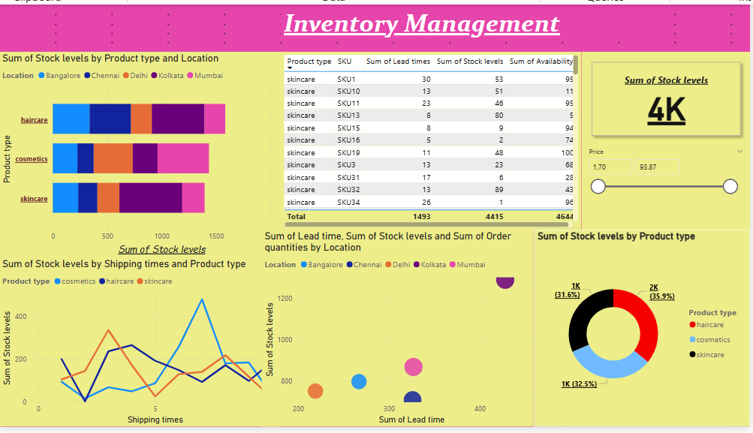
Inventory Management Dashboard
Stacked Bar Chart:
Why Used: To compare stock levels across different product types and locations.
Result: Helps identify which products are overstocked or understocked across various locations.
Table:
Why Used: To display detailed data on product type, SKU, lead times, stock levels, and availability.
Result: Provides a clear overview of all product data for further analysis.
Card:
Why Used: To show the total sum of stock levels at a glance.
Result: Offers a quick snapshot of the overall stock levels across the warehouse.Line
Chart:
Why Used: To analyze the trend of stock levels over shipping time for different product types.
Result: Helps in identifying trends in stock availability and the relationship with shipping times.
Scatter Chart:
Why Used: To visualize the correlation between lead times and stock levels across different locations.
Result: Highlights locations with longer lead times and lower stock levels.
Donut Chart:
Why Used: To show the distribution of stock levels across different product types.
Result: Helps visualize the relative contribution of each product type to total stock levels.

Slide 5
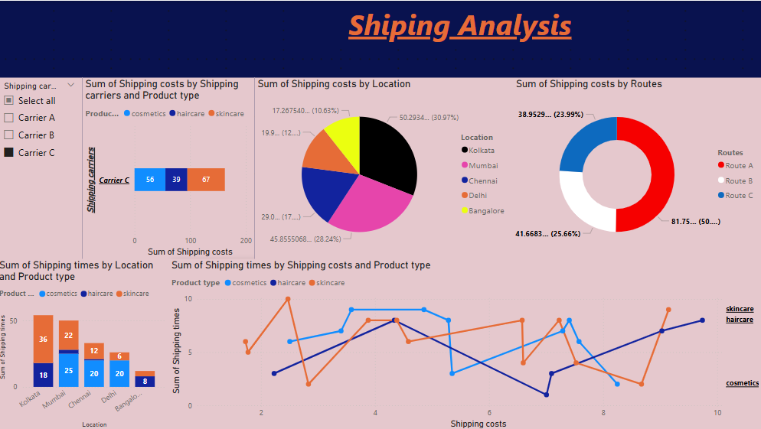
Shipping Analysis Dashboard
Line Chart:
Why Used: To analyze the trend of shipping cost against shipping time, categorized by product type.
Result: Helps identify how shipping cost is impacted by shipping time for different product categories.
Slicer:
Why Used: To filter data based on shipping carriers.
Result: Allows focused analysis on specific carriers and their impact on shipping costs and performance.
Stacked Bar Chart:
Why Used: To compare shipping costs across different carriers and product types.
Result: Helps in understanding the cost distribution across different carriers and product types.
Pie Chart:
Why Used: To show the proportion of shipping costs by location.
Result: Highlights locations with higher or lower shipping costs, aiding in cost reduction strategies.
Donut Chart:
Why Used: To show the distribution of shipping costs by route.
Result: Helps in understanding the cost breakdown by shipping routes.
Stacked Column Chart:
Why Used: To visualize shipping costs by location and product type.
Result: Provides insights into how different locations and product types contribute to total shipping costs.

Slide 6
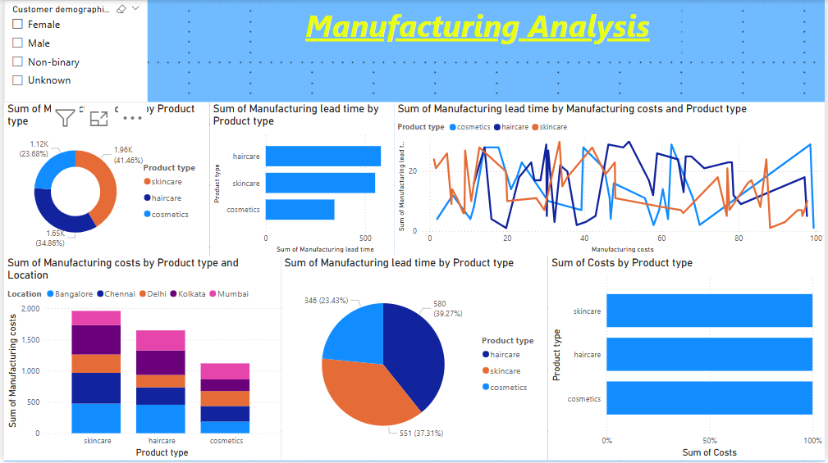
Manufacturing Analysis Dashboard
Slicer:
Why Used: To filter the data based on customer demographics.
Result: Allows segmentation of manufacturing cost data based on customer profiles.
Donut Chart:
Why Used: To show the distribution of manufacturing costs across different product types.
Result: Helps visualize the relative manufacturing cost contribution of each product type.
Stacked Bar Chart:
Why Used: To compare manufacturing costs across different product types.
Result: Identifies which product types incur the highest manufacturing costs.
Line Chart:
Why Used: To analyze the relationship between manufacturing cost and lead time for different product types.
Result: Provides insights into how lead time affects manufacturing costs.
Stacked Column Chart:
Why Used: To compare manufacturing costs by product type and location.
Result: Highlights variations in manufacturing costs across different locations.
Pie Chart:
Why Used: To show the distribution of manufacturing costs across different product types.
Result: Helps identify which product types are the most cost-intensive.
Stacked Bar Chart:
Why Used: To compare manufacturing costs by product type.
Result: Aids in understanding cost trends for each product type.

Slide 7
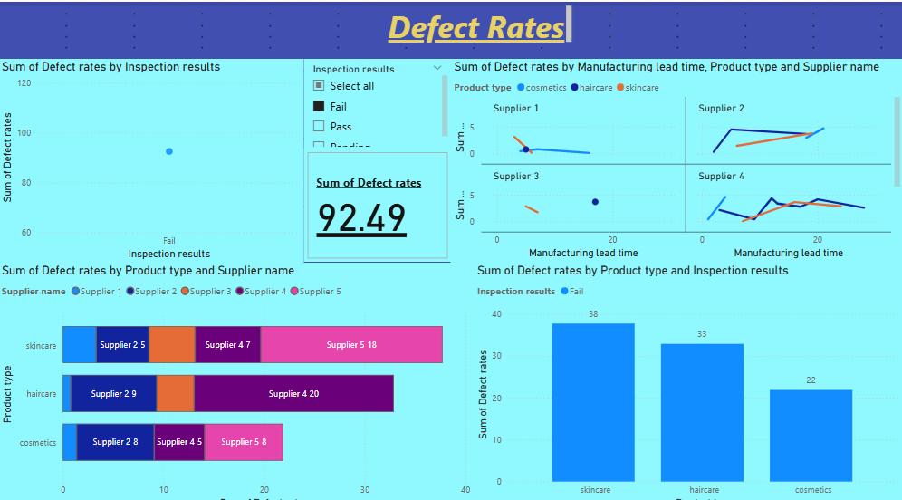
Defect Rates Analysis Dashboard
Scatter Chart:
Why Used: To analyze the relationship between inspection results and defect rates.
Result: Helps identify any patterns or correlations between inspection outcomes and defect rates.
Slicer:
Why Used: To filter the data based on inspection results.
Result: Allows focused analysis of defect rates based on specific inspection results.
Card:
Why Used: To show the total sum of defect rates.
Result: Provides a quick overview of the overall defect rate across products.
Line Chart:
Why Used: To show the trend of defect rates over manufacturing time.
Result: Helps identify if defect rates are improving or worsening over time.
Stacked Bar Chart:
Why Used: To compare defect rates by product type and supplier.
Result: Helps identify which suppliers or product types have higher defect rates.
Stacked Column Chart:
Why Used: To analyze defect rates by product type and inspection results.
Result: Provides insights into how inspection outcomes affect defect rates across product types

Slide 8
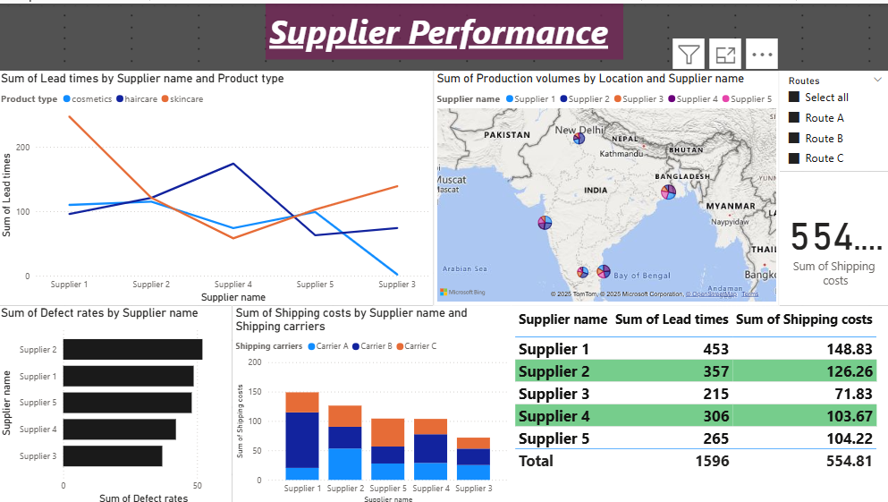
Supplier Performance Analysis Dashboard
Line Chart:
Why Used: To analyze the relationship between lead times and supplier performance by product type. Result: Helps identify suppliers with long lead times and how it impacts different product categories.
Map:
Why Used: To visualize the geographic distribution of suppliers and their performance.
Result: Helps in understanding regional performance differences among suppliers.
Clustered Bar Chart:
Why Used: To compare defect rates by supplier name.
Result: Helps identify suppliers with higher defect rates and potential areas for improvement.
Stacked Column Chart:
Why Used: To compare shipping costs by supplier and shipping area.
Result: Provides insights into how different suppliers contribute to overall shipping costs.
Table:
Why Used: To display supplier data with lead times and shipping costs.
Result: Provides a detailed overview for further analysis of supplier performance.

Slide 9
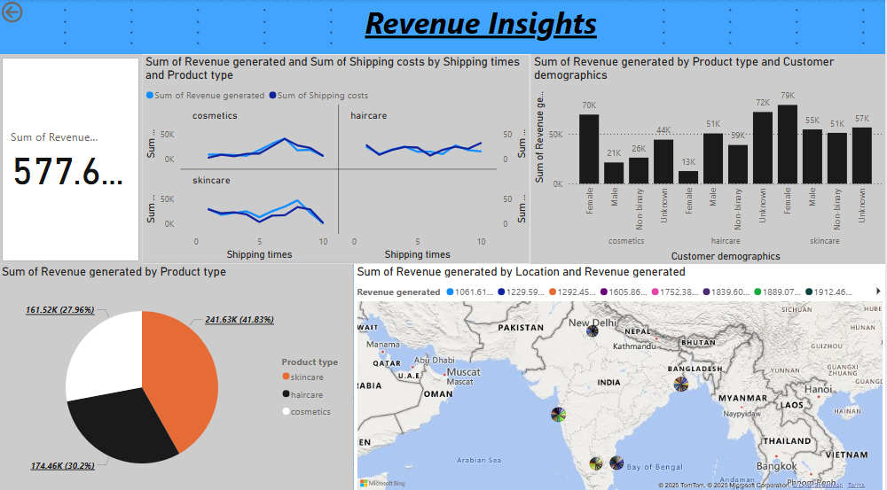
Revenue Insight Dashboard
Card:
Why Used: To display total revenue at a glance.
Result: Provides a snapshot of total revenue for quick decision-making.
Line Chart:
Why Used: To analyze the relationship between shipping time and revenue generated, with a secondary axis for shipping costs.
Result: Helps identify how shipping time and costs impact revenue generation.
Pie Chart:
Why Used: To show the proportion of revenue generated by each product type.
Result: Helps in understanding which products generate the most revenue.
Clustered Column Chart:
Why Used: To compare revenue generation by product type and customer demography.
Result: Provides insights into how revenue generation is influenced by customer profiles and product types

Slide 10
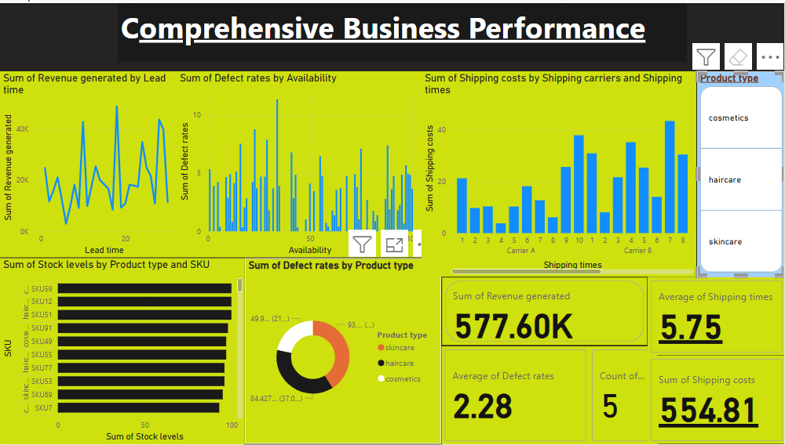
Comprehensive Business Performance Analysis
Line Chart:
Why Used: To analyze the relationship between lead time and revenue generated
Result: Helps identify if reducing lead times can increase revenue.
Standard Column Chart:
Why Used: To compare availability with defect rates and lead times.
Result: Helps understand how product availability affects defect rates and lead times.
Standard Column Chart:
Why Used: To analyze the relationship between shipping area and shipping times with shipping costs.
Result: Provides insights into how shipping area and times influence shipping costs.
Standard Stacked Bar Chart:
Why Used: To compare stock levels and product type.
Result: Helps in understanding how product types relate to stock levels across different categories.
Donut Chart:
Why Used: To show the contribution of product types to defect rates.
Result: Identifies which product types are responsible for higher defect rates.

Slide 11

Conclusion
📊 Supplier Performance Analysis
Identifies delays, defect rates, and cost impacts across suppliers.
📈 Revenue Insight Dashboard
Highlights revenue trends, product performance, and shipping cost impact.
🔍 Comprehensive Business Performance Analysis
Integrates supply chain, shipping, and stock levels for strategic decision-making.
✅ Key Takeaway
These dashboards enable data-driven decisions, optimizing operations and improving business performance.

Slide 12


Insights and Outcomes
1. Revenue Insights: Identified top-performing and underperforming products to optimize focus and
strategies.
2. Inventory Management: Determined optimal stock levels to prevent stockouts and overstocking.
3. Logistics Efficiency: Highlighted cost-effective transportation modes and routes, minimizing delays and
shipping costs.
4. Supplier Performance: Identified suppliers causing delays or defects, aiding in performance

Slide 13


Thank You

